Slide 1
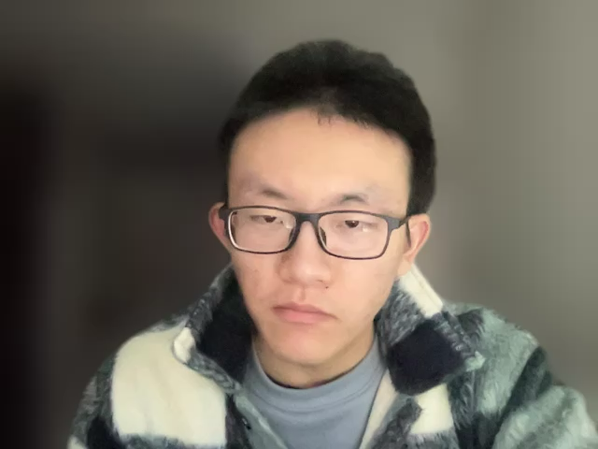
Educational Revolution-----
Workshop4 Group6

Slide 2
Problem:
Students over-rely on ChatGPT
Students use ChatGPT to cheat.

Slide 3
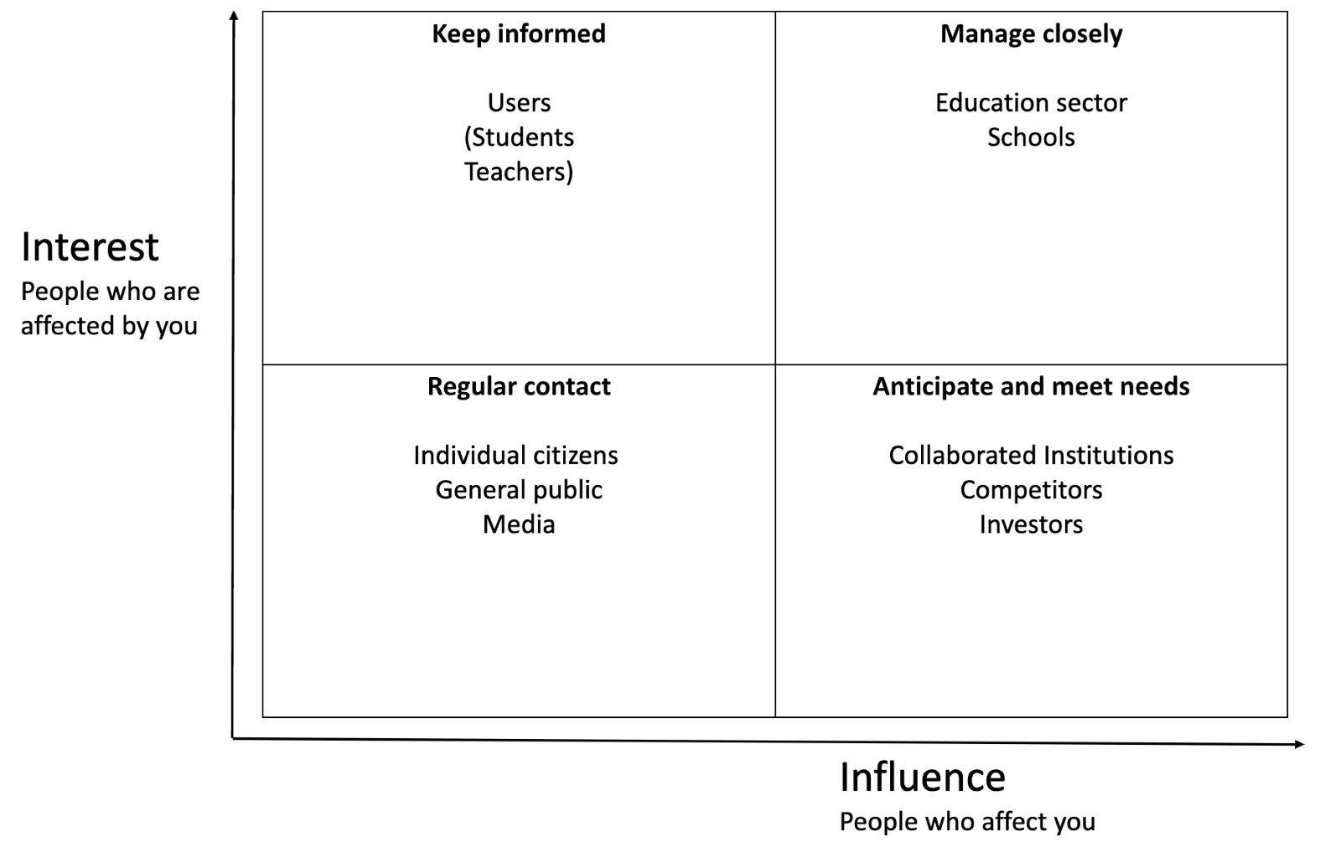
Stakeholders:

Slide 4
Solution:
Assist with homework
Assist with thinking

Slide 5

What is Dandelion
“Teaching to the individual”
Teach students how to use chatgpt correctly

Slide 6
How to Use Dandelion
Learning Process
As now
1
After-school thinking
Ask chatGPT questions
2
Quiz and assignment
Customized
3

Slide 7
Responsibility
Privacy
Reliability
Accuracy

Slide 8
Expected outcomes
Advocate for responsible AI
Personalized teaching modes
A complement to human teaching

Slide 9
Thanks for your listening

